Slide 1
Thinking about message
Describing a new model (fast, ML-enabled)
Compare/contrast to existing methods
Solution: combo of methods
New method – easy, but limited to sizes > pixel (higher MP = smaller particles resolved)

Slide 2
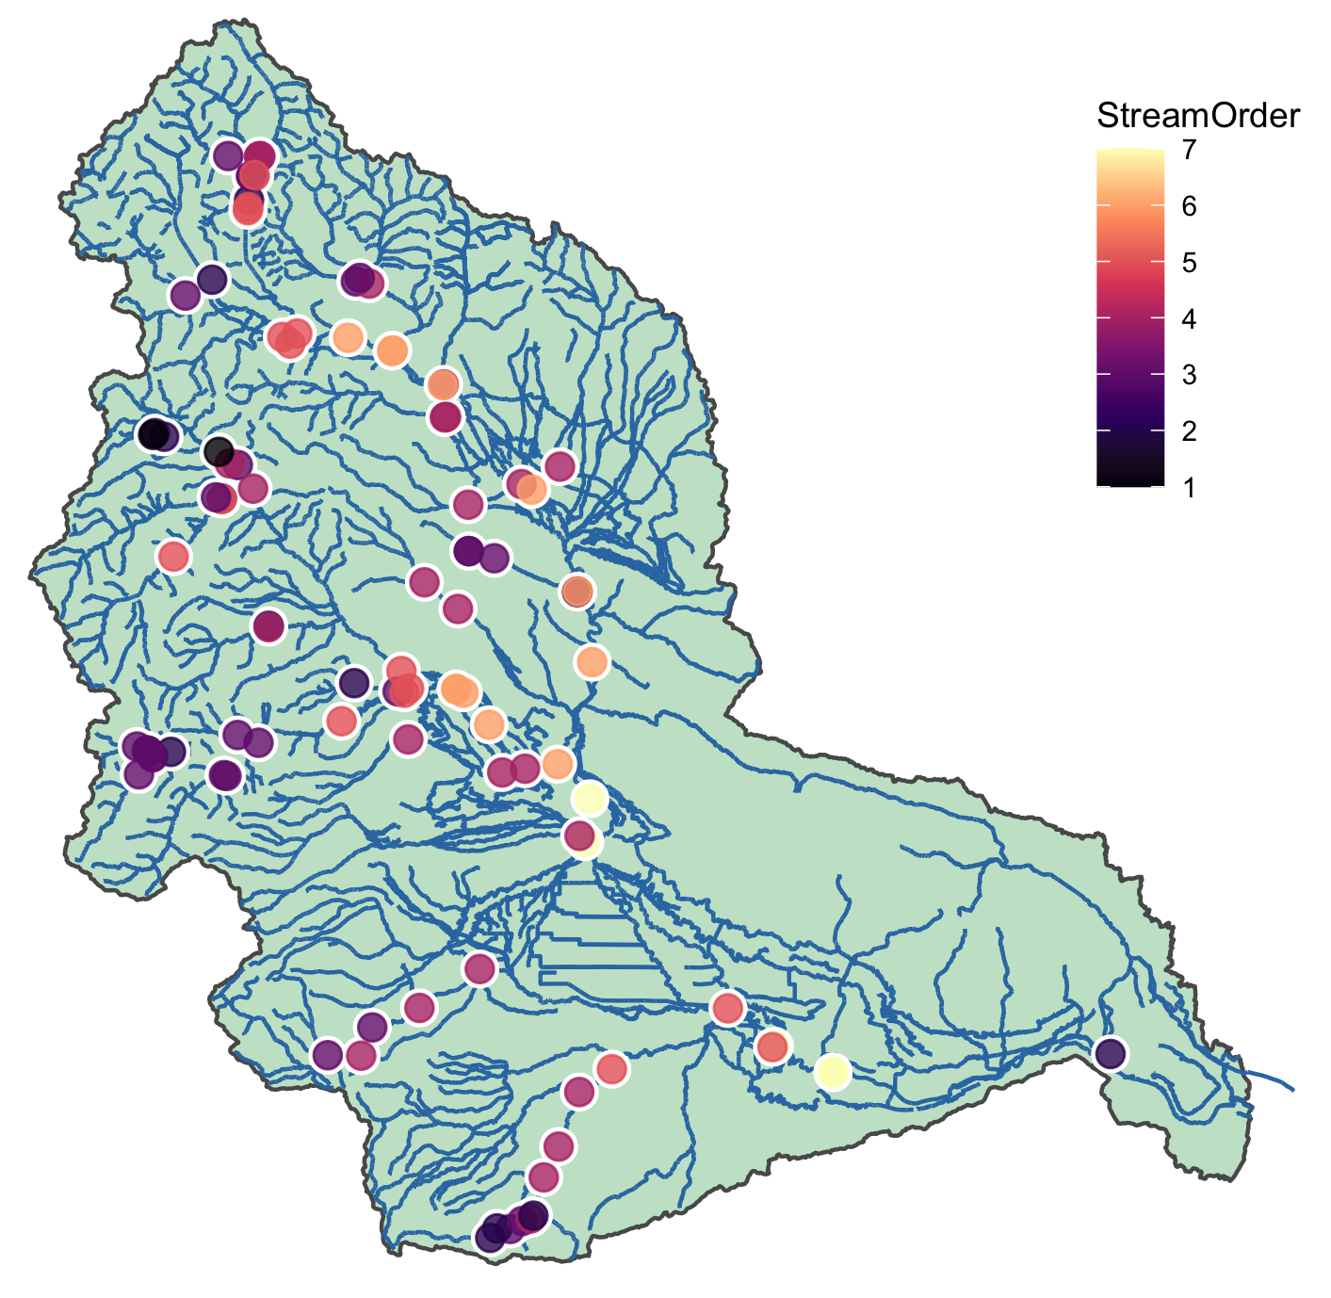
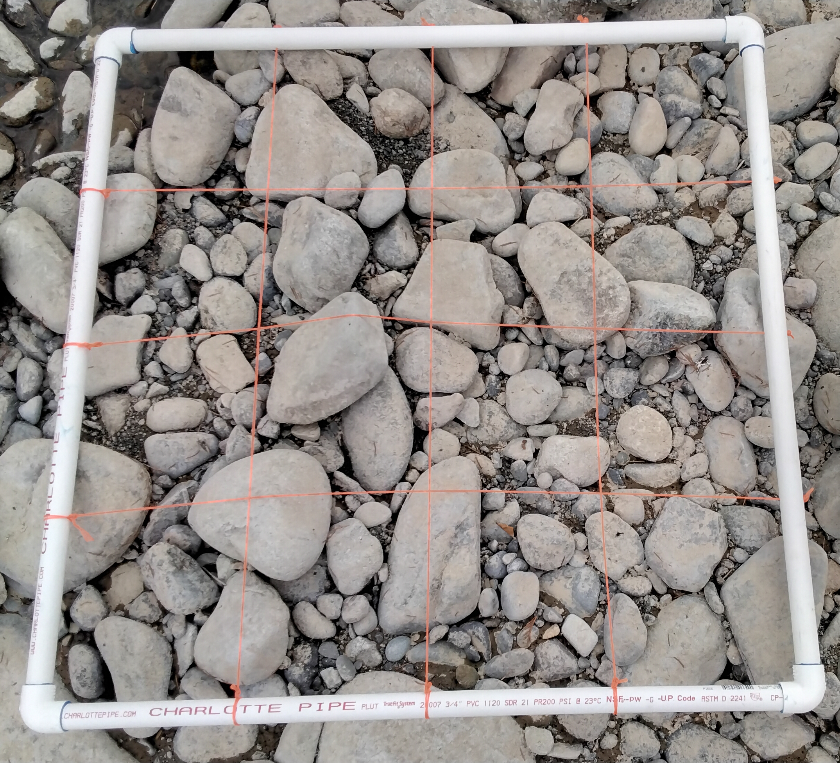
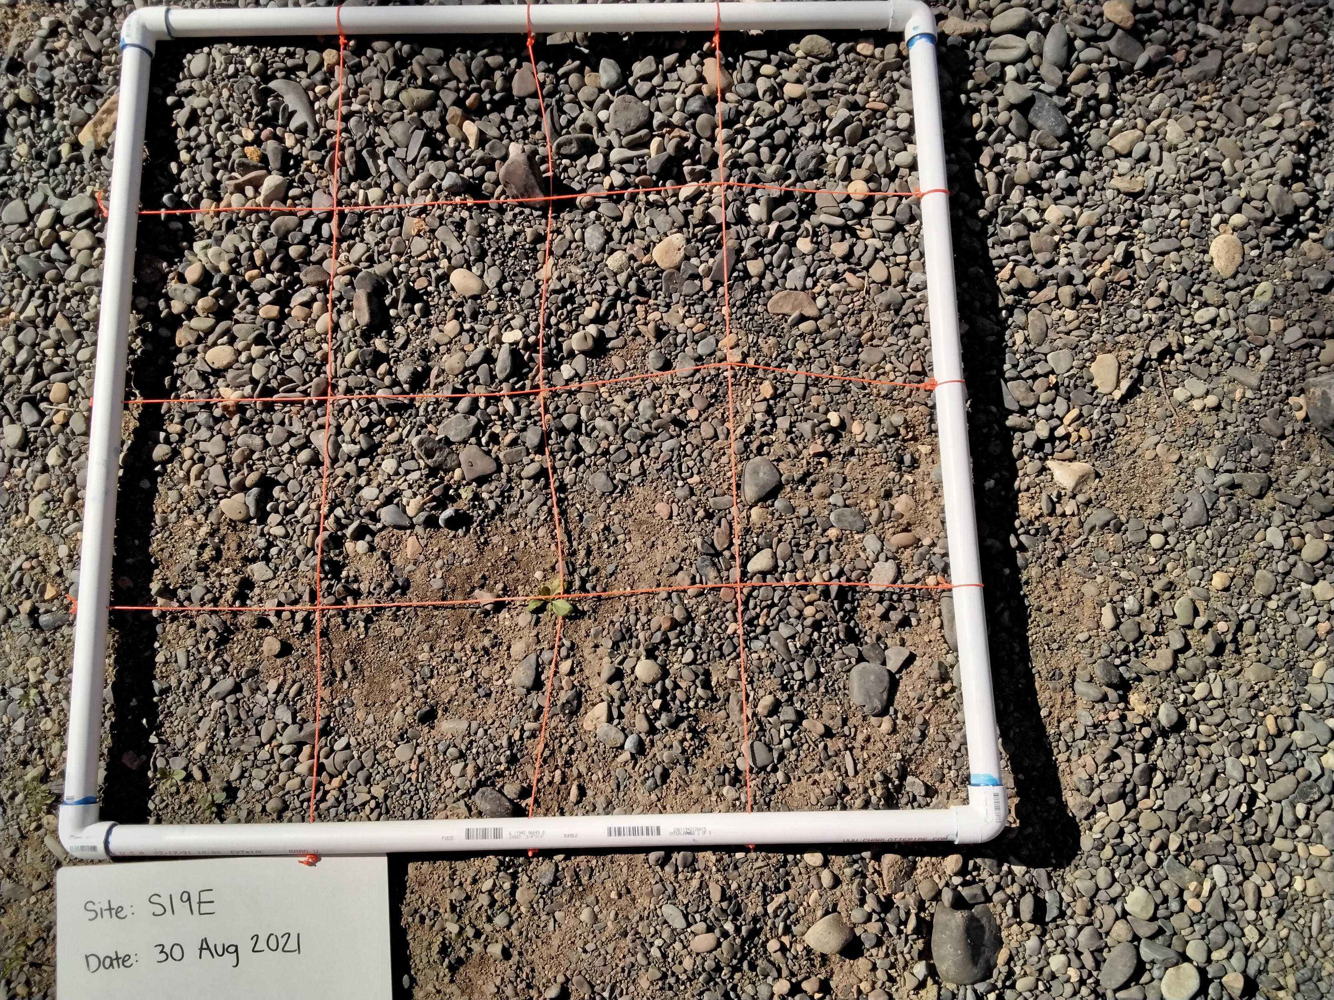
Figure 1 presents a map showing the characteristics of our samples, and two examples of pictures used to
Estimate d50
A
B
C
https://www.flickr.com/photos/ecologywa/34053439771 for map color inspiration

Slide 4
Table comparing different methods and different biases/caveats
Method | Source | Procedure | Limitations
USGS |  | Manually sieve | Excludes > 2mm
NEXSS
Abeyshu et al. 2022

Slide 5
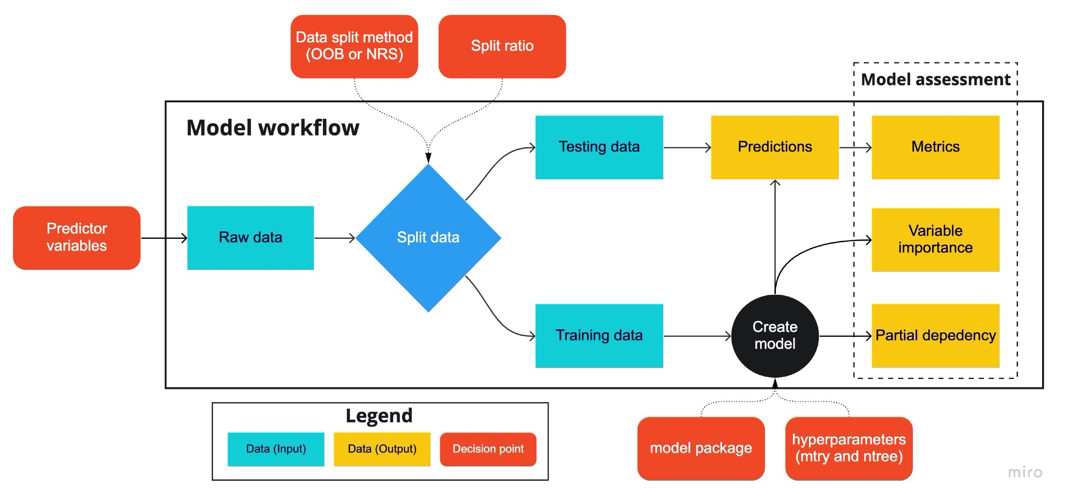
Figure 2 (or supplemental if less important): workflow and example of YOLO ID
Include pictures of how USGS/etc are calculating to show differences in methods
This should be a table: method, limitations, parameters, etc

Slide 6
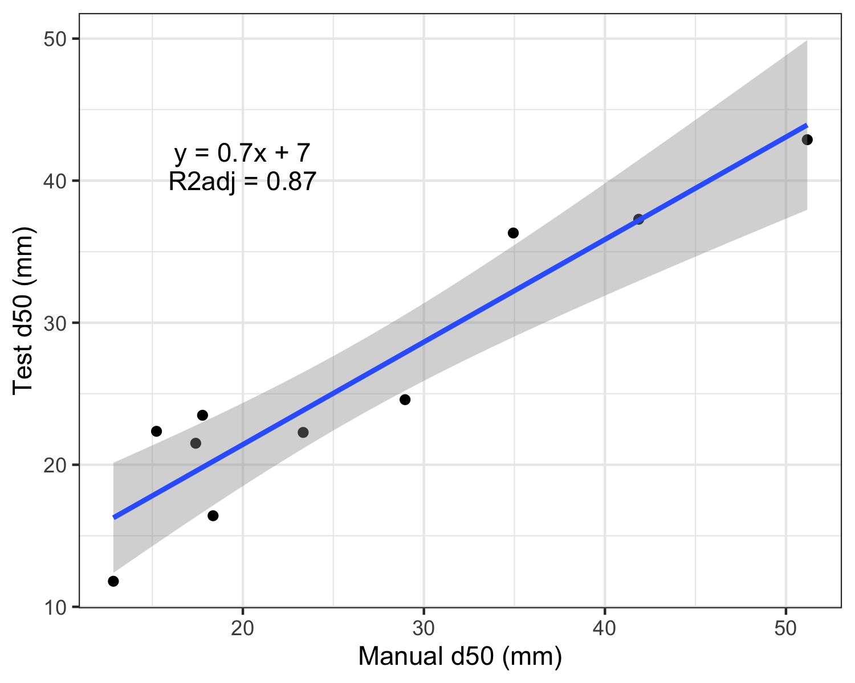
Some sort of figure or table that shows how well the model performed.
Based on first iteration, will improve (more samples and better fit) with next iteration
7/22: YC says R2 = 0.888, update after 7/28 meeting
This is based on d50_Train1_Prediction1_40.csv

Slide 7
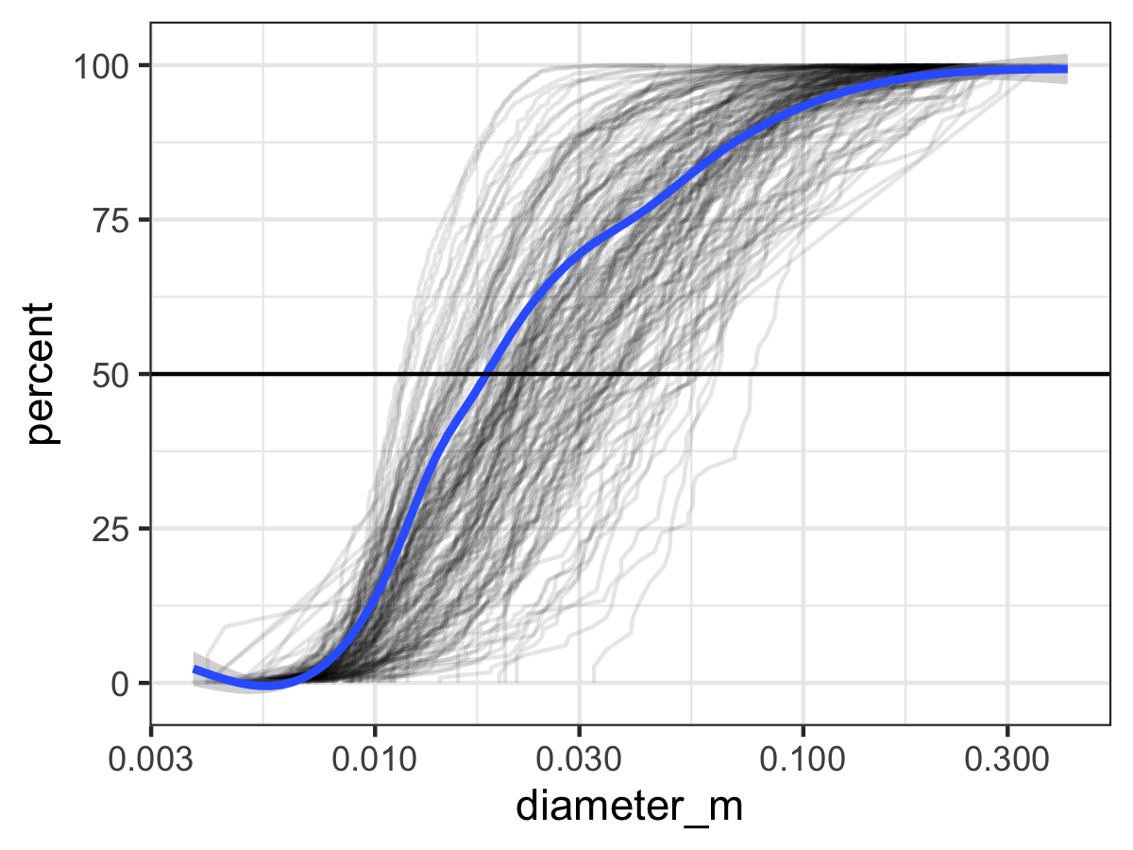

Slide 8
Image LOD
Alternative to boxplots for comparing distributions
Addresses “who is right”? Comes down to methods and associated bias
Resolution is 0.2-0.6 mm

Slide 9
Compare how consistent YOLO estimates are for different pictures across the same site

Slide 10
Gupta
Do patterns make sense with what we know about
Watershed characteristics? How do differences in patterns here relate back to methodological differences, and what might that tell us about bias?
NEXSS
d50
YOLO
Stream Order

Slide 11
Hypothesis-driven linkages between watershed characteristics Guta/NEXSS/d50
Which d50 estimate matches hypothetical relationships the best?
Different linear relationships OR lack of relationships
D50
Watershed characteristic that we expect to drive d50

Slide 12
Other images that may be useful
Maps of YRB for NEXSS, Guta, YOLO to compare spatial patterns
Comparison of sites with multiple images
Correlation between number of items and size (color by confidence)
Additional metrics (SF etc)
Boxplot: yes/no/maybe v confidence (human and computer vision match)

Slide 13
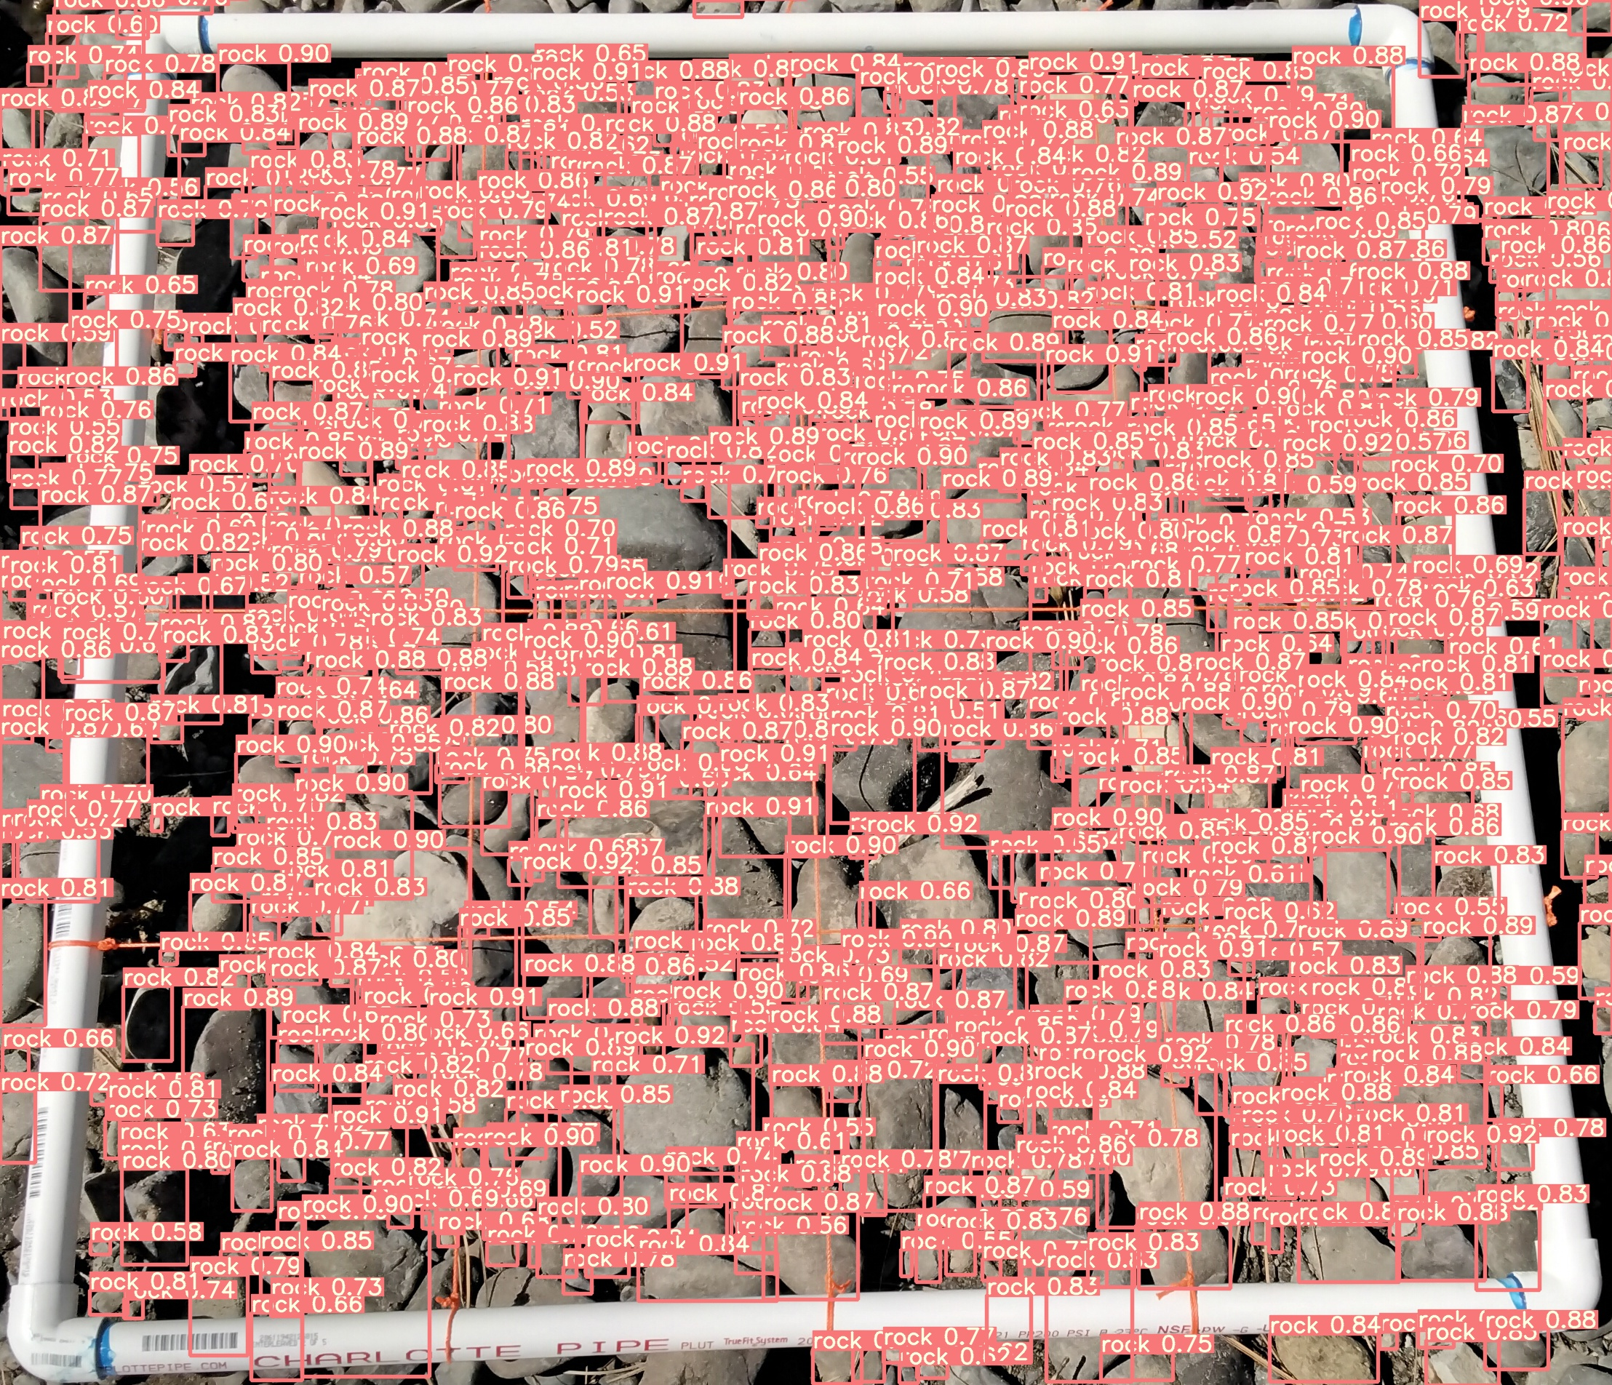
D50s for all YOLOs
Important to show the raw data (distributions) –
Figure out how to best show that

Slide 14
USGS
Will be YOLO
Add YOLO
Add YOLO
D50s for all YOLOs

Slide 15
Smallest particle resolved
MP
Should be a completely straight line, but highlighting how a better camera will help resolve more sand particles

Slide 16
Next paper
Respiration rate boxplots by d50 input

